Slide 1
Branding and customization
Site Designs, Provisioning and Formatting

Slide 3
How to View This Presentation
To switch to Notes Page view:
On the ribbon, click the View tab, and then click Notes Page
To navigate through notes, use the Page Up and Page Down keys
Zoom in or zoom out, if required
In the Notes Page view, you can:
Read any supporting text—now or after the delivery
Add notes to your copy of the presentation, if required
Take the presentation files home with you

Slide 4
Overview
In this Lesson
Site designs and site scripts
Column formatting
Combination Provisioning concepts
Conditional formatting

Slide 5
Objectives
Learn about column formatting
Understand Site Designs and Site Scripts application
Be aware of combination provisioning scenarios for SPO

Slide 6
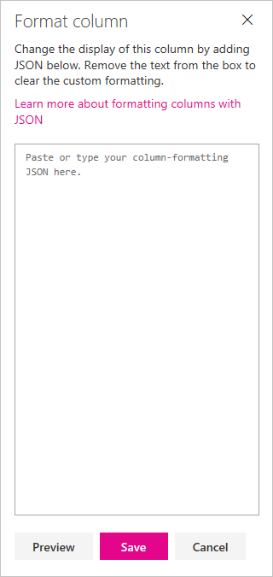
Column Formatting
Available in SharePoint 2019 & Online
Site owners have the ability to format columns more easily
Defined using JSON schema Does not change data; just display
Conditional Formatting bases on values and ranges
Action links
Data visualizations
Select ’Format this column’ under ’Column Settings’ on drop-down
Preview & Save
Notes:
Custom scripts using JS or alike on the page were the ways in which you used to apply formatting to columns. However, with the modern experience with an easy JSON block, you are able to achieve the same.
https://docs.microsoft.com/en-us/sharepoint/dev/declarative-customization/column-formatting

Slide 7
Apply Conditional Formatting (Basic)
{
"$schema": "http://columnformatting.sharepointpnp.com/columnFormattingSchema.json",
"debugMode": true,
"elmType": "div",
"attributes": {
"class": {
"operator": "?",
"operands": [
{
"operator": "<=",
"operands": [
"@currentField",
70
]
},
"sp-field-severity--warning",
""
]
}
}
}
"children": [
{"elmType": "span",
"style": {
"display": "inline-block",
"padding": "0 4px"
},
"attributes": {
"iconName": {
"operator": "?",
"operands": [{
"operator": "<=",
"operands": [
"@currentField",
70]},
"Error",
""
]}}},
{
"elmType": "span",
"txtContent": "@currentField"
}]}
Notes:
For more samples, check out GitHub: https://github.com/pnp/sp-dev-list-formatting and https://docs.microsoft.com/sharepoint/dev/declarative-customization/column-formatting

Slide 8
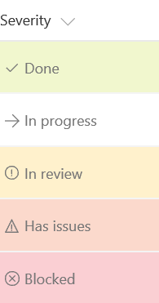

Apply Conditional Formatting
Basic Outcome
Advanced Outcome
Notes:
These are two very basic examples that look at field values to display color formatting.
Basic Outcome is based on the previous slide input and number field.
Advanced outcome would be if several of the Office UI Fabric UI elements were displayed based on text or choice field.

Slide 9
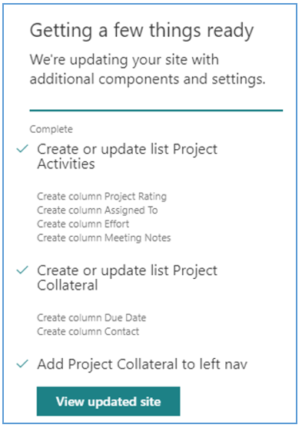
Site Designs and Site Scripts
Only available in SharePoint Online
Custom configuration templates
Can be applied to new or existing modern sites
Register with modern template sites:
Team Site (64), Communication (68), group-less sites (1)
Can be permission scoped
Progress pane displayed to users
REST API and PowerShell support
Typcial actions:
Set site theme
Create lists
Starting a Microsoft Flow / Power Automate
External sharing capability
Notes:
Site Designs and Site Scripts should be tried first for less complex provisioning. For more complex provisioning, you can still execute PnP Provisioning or custom scripts, discussed later.
Site Designs and Site Scripts now supports applying to existing site collections. In addition, you can update site designs and scripts though REST or PS commands.
You can scope these to only be visible to a set of users or group defined. By default, they are available to everyone (discussed in depth in a later slide).
https://docs.microsoft.com/en-us/sharepoint/dev/declarative-customization/site-design-overview

Slide 10
Site Scripts Sample
{
"verb": "addSPField",
"fieldType": "Number",
"displayName": "Requisition Total",
"addToDefaultView": true,
"isRequired": true
},{
"verb": "addSPField",
"fieldType": "User",
"displayName": "Contact",
"addToDefaultView": true,
"isRequired": true
},
{
"verb": "addSPField",
"fieldType": "Note",
"displayName": "Meeting Notes",
"isRequired": false
}
]
}
],
"bindata": { },
"version": 1
}'@
$site_script = @'
{
"$schema": "schema.json",
"actions": [
{
"verb": "createSPList",
"listName": "Customer Tracking",
"templateType": 100,
"subactions": [
{
"verb": "SetDescription",
"description": "List of Customers and Orders"
},{
"verb": "addSPField",
"fieldType": "Text",
"displayName": "Customer Name",
"isRequired": false,
"addToDefaultView": true
},
Notes:
Creates ‘Customer Tracking’ list with ‘Customer Name’, ‘Requisition Total’, ‘Contact’ and ‘Meeting Notes’ fields.
An interesting website to easily build site designs is https://www.sitedesigner.io

Slide 11
Getting Started with Site Designs and Site Scripts
PnP PowerShell
Connect-PnPOnline -Url https://tenant-admin.sharepoint.com -UseWebLogin
Add-PnPSiteScript -Title "Create customer tracking list" -Content $site_script -Description "Creates list for tracking customer contact information“
Add-PnPSiteDesign -Title "Contoso customer tracking" -WebTemplate "64" -SiteScripts "<ID>" -Description "Tracks key customer data in a list“
Note: Replace <ID> with ID created from Add-PnPSiteScript
Test new site design
Go to SharePoint home page (https://<tenant>.sharepoint.com/_layouts/15/sharepoint.aspx)
Click ‘+Create site’ > Choose Team Site > Choose site design
Create site and check for results
Notes:
Site Designs and Site Scripts will need to be maintained by SharePoint Online Administrator via the SharePoint Online PowerShell Module, PnP PowerShell, Office 365 CLI or an app using the REST API. For more information, see: https://docs.microsoft.com/en-us/sharepoint/dev/declarative-customization/get-started-create-site-design

Slide 12
Site Design Scope
Available to everyone by default
Can be scoped to users or groups
PnP PowerShell
# Grant view rights on a site design
Grant-PnPSiteDesignRights `
-Identity 44252d09-62c4-4913-9eb0-a2a8b8d7f863 `
-Principals "nestorw@contoso.onmicrosoft.com",“marketing@contoso.onmicrosoft.com" `
-Rights View
Notes:
Certain templates might want to displayed to a certain audience. E.g. the Finance team sees the new Finance Project site design from create site.
https://docs.microsoft.com/en-us/sharepoint/dev/declarative-customization/site-design-scoping

Slide 13
Site Design IsDefault
Use the IsDefault switch to apply the site design
64 for all new Modern Team Sites & sites created via an Office 365 such as via MS Teams
68 for all new Modern Communication sites
1 for the group less Team Site
PnP PowerShell
# Applies company these to all communication templates
Add-PnPSiteDesign `
-Title "Contoso company theme" `
-WebTemplate "68" `
-SiteScripts "89516c6d-9f4d-4a57-ae79-36b0c95a817b" `
-Description "Applies standard company theme to site" `
-IsDefault
Notes:
If you would like a certain company themse applied to all new site collections provisioned by end-users; use the –IsDefault switch.
https://docs.microsoft.com/en-us/sharepoint/dev/declarative-customization/customize-default-site-design

Slide 14
Combination Site Provisioning
For items not covered by site designs, for example:
Deploy SPFx web part or extension
Deploy site files and list items
Customize permissions
Modify home page
Apply site policies or classification
Activate site policies
Managed metadata services
Managed navigation
Hybrid site provisioning
Notes:
Methods such as PnP Site Provisioning are available for both SPO and on-premises. Also, this method has been around a lot longer so supports more advanced scenarios than Site Designs and Site Script.

Slide 15
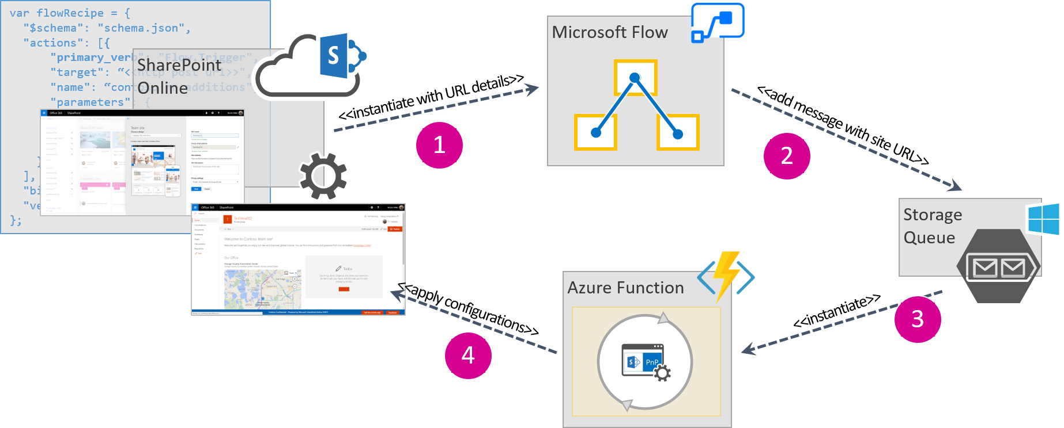
Combination Site Provisioning Sample
A site design and site script
Microsoft Flow / Power Automate
Azure Queue storage
Azure Function
SPFx solution
PnP provisioning template
PnP PowerShell script
Registered App
Notes:
First, you need to register an app on your SharePoint site to get an Oauth Client ID and Secret.
Next, Site Designs and Site Scripts is an example of an entry point you could use to kick off a Flow. Of course it is not the only method, some might choose to use a custom form.
Once the MS Flow is triggered, a request with parameters can be sent to the Azure Function which has an Azure Queue with request details. Custom PnP Provisioning Template can be store in the Azure Function to do actions such as deploying an SPFx Application Customizer with footer.
https://docs.microsoft.com/en-us/sharepoint/dev/declarative-customization/site-design-pnp-provisioning

Slide 16
Lesson Summary
Column formatting
Site designs and site scripts
Combination site provisioning

Slide 17
Questions?

Slide 18
Lab - Site Designs, Provisioning and Formatting
In this lab you will create a site design, use PnP Provisioning and learn how to work with SharePoint field formatting.
Time estimation: 30 minutes

